Slide 1
Project 1 Tutorial
10520 CS410001
Computer Architecture, Prof. Tsay
2017.02.23
TA – 金國丞
TA – 黃柏瑀
TA – 呂宗穎

Slide 2
Outline
About Project 1
Submission & Grading Policy
Development Environment
Notes:
介紹project1需要大家做什麼
Project繳交的時間和格式,以及評分的方式
會要求大家連到一台伺服器編寫和測試,所以會簡單和大家介紹遠端連線的方式和可能會用到的一些指令以及工具

Slide 3
Outline
About Project 1
Submission & Grading Policy
Development Environment

Slide 4
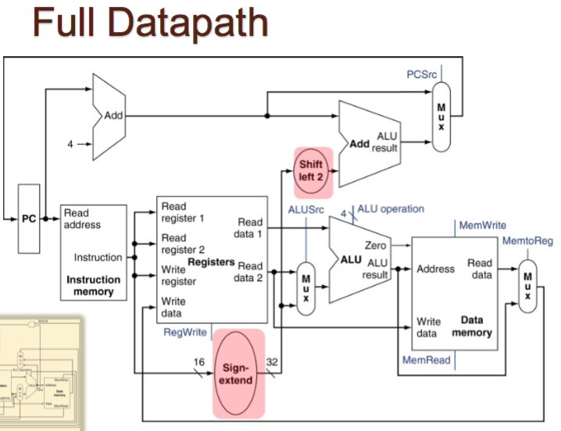
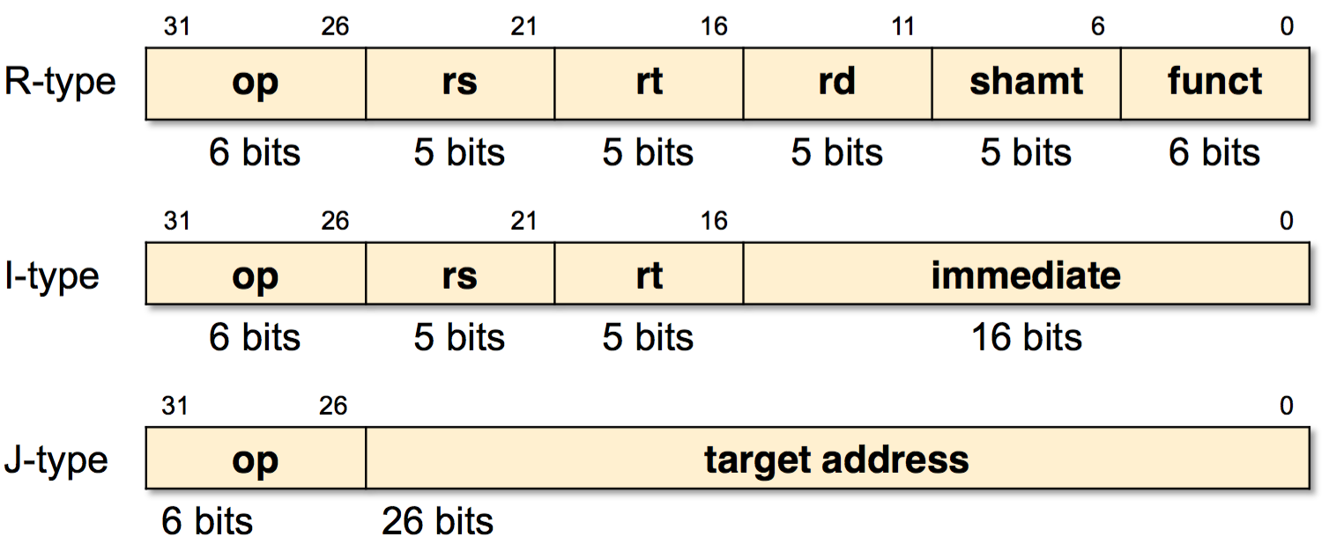
Design Single Cycle Processor
Design your simulator
Simulator
Appendix A
Notes:
設計一個single cycle的模擬器,能夠執行所有定義在appendix a的mips指令
那同學可以對照課本所附的架構圖去設計你的模擬器

Slide 5
Design Test Cases
Input
Simulator
Output
Design your test case
Record
& Error Message
Test Case
Evaluate your test case
Notes:
Simulator設計好之後,你們需要設計測試資料去測試你的simulator
並從simulator的輸出去驗證結果是否正確.
所以你的測資

Slide 6
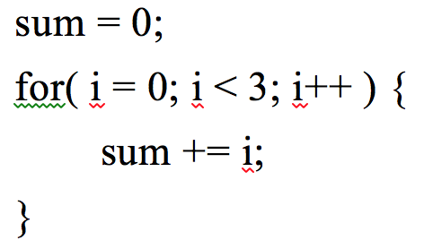
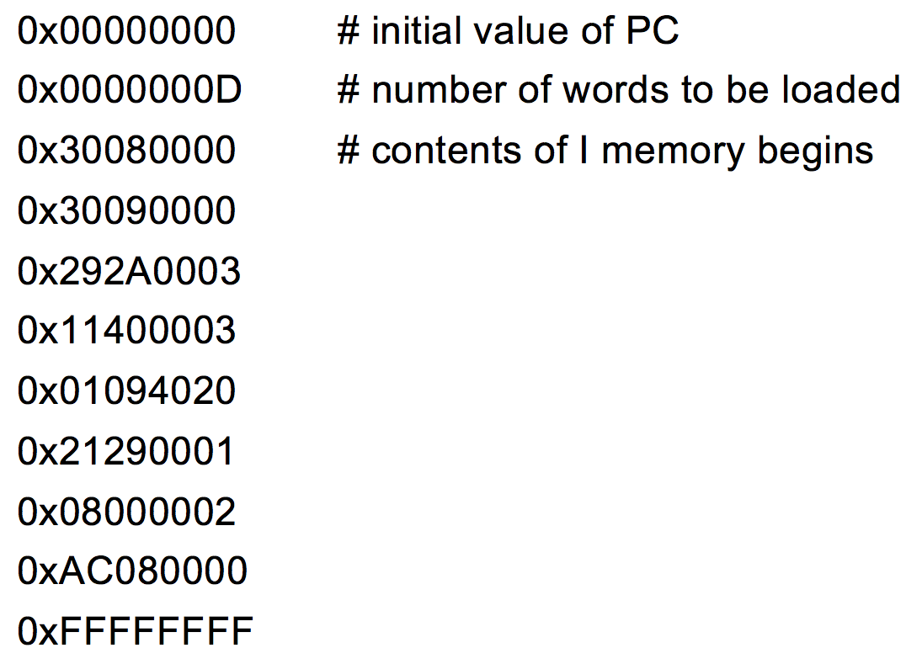
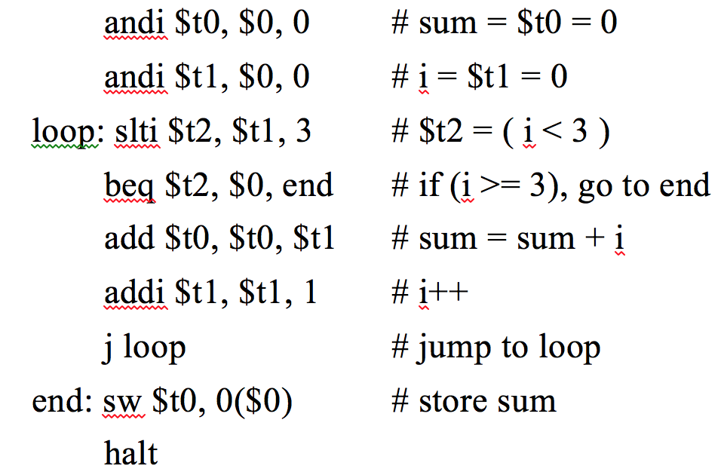
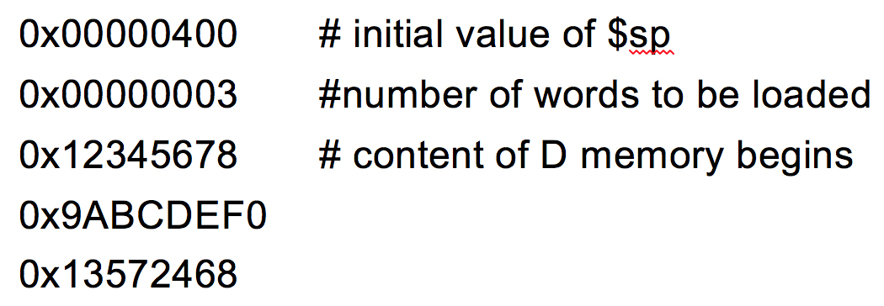
Input: Instruction Memory and Data Memory
C program
Instruction
Memory
(iimage.bin)
Assembly
Appendix B
Data
Memory
(dimage.bin)
Notes:
assembly 拆成兩部分

Slide 7
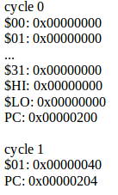
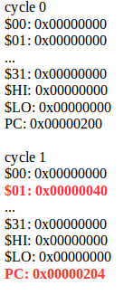
Output: Some Records
Register Content
(snapshot.rpt)
Error Message
(error_dump.rpt)
In cycle 2: Write $0 Error
In cycle 5: Number Overflow
In cycle 7: Number Overflow
In cycle 8: Misalignment Error
In cycle 10: Overwrite HI-LO registers
Appendix C& D

Slide 8
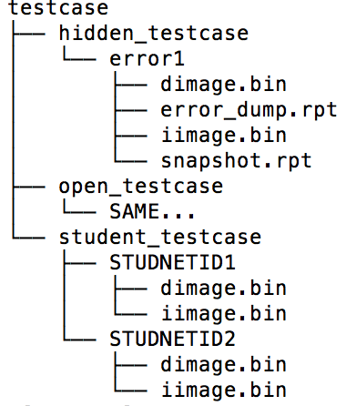
Test Pool: More test cases
iimage.bin
dimage.bin
Input
Simulator
Output
Design your test case
Design your test case
Record
& Error Message
Test Case Pool
Test Case
Other students’
test cases
TA’s test cases
Notes:
最後我們會收集所有同學繳交的測資去驗證你們的simulator.加上我們助教的一些hidden testcase.

Slide 9
Summary
Design your simulator
Input
Simulator
Output
Record
& Error Message
Test Case Pool
Grade your
simulator.
$ diff file1 file2:
Compare two files
to check differences.
Golden
Simulator
Notes:
Golden產生檔案

Slide 10
Outline
About Project 1
Submission & Grading Policy
Development Environment

Slide 11
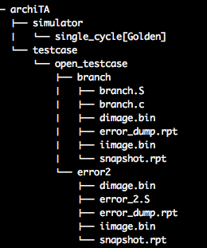
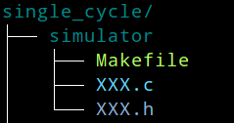
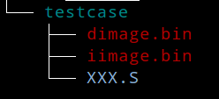
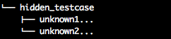
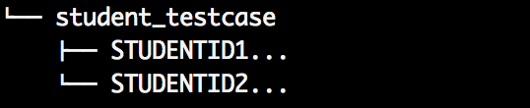
Before 1st Submission
(Before 3/26)
Cloned from GitHub.
Use ”Open Test-case” to Verify your code.
Correctness: (25%)
- Open (15%)
- Hidden (5%*correct ratio)
- Students’ (5%*correct ratio)
Test case:(20%*(1-1.5^{-n}))
Design and submit one test case for pool test.
Your test-case
unknown hidden test case.
Other students’ test cases.

Slide 12
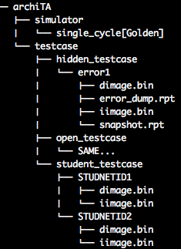
Before 2nd Submission
Report Format
Project Description
1-1) Program Flow chart
1-2) Detailed Description
Test case Design
2-1) Detail Description
of Test case
(3/27-4/02)
Copy from server.
Add “Hidden Test-case” & “Students’ Test-case”
to verify your code.
Correctness: (30%)
- Open (5%)
- Hidden (10%*correct ratio)
- Students’ (15%*correct ratio)
No test case submission.
Performance: (5%)
Report & Demo: (20%)
After 2nd Submission
Demo
Quiz on dev. environment
Quiz on your project report
(After 4/02)
Notes:
Performance = run time

Slide 13
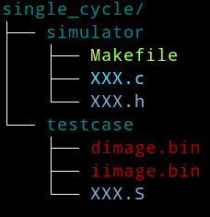
Submission Package
1st Submission:
single_cycle.tar.gz of your simulator and test case.
2nd Submission:
single_cycle.tar.gz of your simulator.
Your report: studentID_report.pdf
tar.gz
tar.gz
Report

Slide 14
Working flow
Start your project
After finishing your project
Use SSH to login into workstation
Check your project format and
compress the folder by test_script.py
Clone sample files from GitHub
to your home repository
Download tar.gz to your own
computer& Upload tar.gz & report
Do Coding/Debugging/Testing
using Git version control tool
Design your own test case
for pool test

Slide 15
Note
GitHub https://github.com/logoslab/Archi2017_Project1
Verify your package format by executing test_script.py before each submission. Wrong submission format earns no points. ($ python test_script.py)
File compression format is restricted to be tar.gz.
For convenience, please synchronize your submission code with your code in workstation. This allows smoother demo on workstation.

Slide 16
Outline
About Project 1
Submission & Grading Policy
Development Environment

Slide 17
Development Environment
Unix-like Workstation
Makefile: Compile & Link your program
GDB Debugger: Debug your program.
Git & GitHub: Revision Control & Collaboration.
Notes:
Unix-like Environment: Shell Command/SSH/SFTP/ Editor(VIM)
Some Development Tools: tar.gz / script

Slide 18
Development Environment
Unix-like Workstation
Makefile: Compile & Link your program
GDB Debugger: Debug your program.
Git & GitHub: Revision Control & Collaboration.

Slide 19
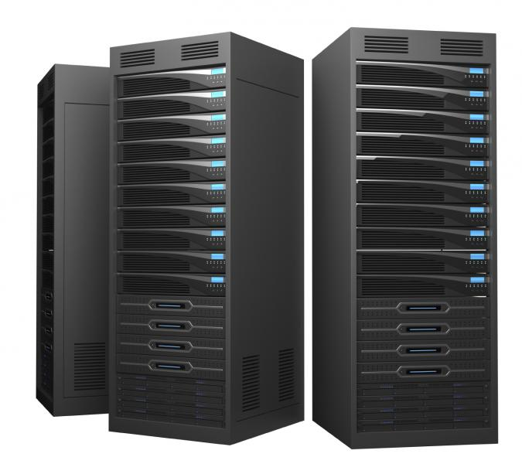


SSH/SFTP: Connect to workstation
SSH: Connect to Remote Server (Workstation)
SFTP: Remote File Transfer
SSH/SFTP Protocol
Your Computer
Linux Server

Slide 20
Common Linux Commands
path: /home/archi/……
pwd: Display the current directory
cd path: Change directory
ls: List all files under current directory
mkdir directory: Create a new directory
mv old_path new_path: Move/Rename file.
cp old_path new_path [-r]: Copy file or directory.
rm old_path new_path [-r]: Remove file or directory.

Slide 21
Common Linux Commands
man command: command manual pages.
command --help: Show the command’s detail on screen.
exit: Logout the terminal.
<Ctrl+C>: Terminate the command/program.
<TAB>: Auto-complete the path or command.
Linux Tutorial

Slide 22
Class Workstation
Server IP Address:
140.114.75.143
Account:
s + Your Student ID, e.g. s103062703
Default Password:
s + Your Student ID, e.g. s103062703
You are required to change your password at the first login.
Every user has 2GB disk space quota.

Slide 23

SSH/SFTP: From Linux/OS X
Terminal
SSH login
ssh USER@HOST –p 13579
E.g. ssh s103062703@140.114.75.143 –p 13579
SFTP file transfer
HOST1 → HOST2, where HOST = local or server
scp [-r] [-p][[USER1@]HOST1:]PATH1 [[USER2@]HOST2:]PATH2
E.g. (Download file from server)
scp s103062703@140.114.75.143 –p 13579:~/hello.c ~/hello2.c
[ ]: Means optional. [-r]: recursive (for directory)

Slide 24
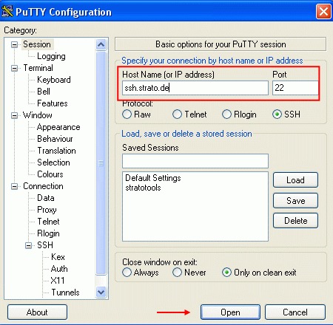
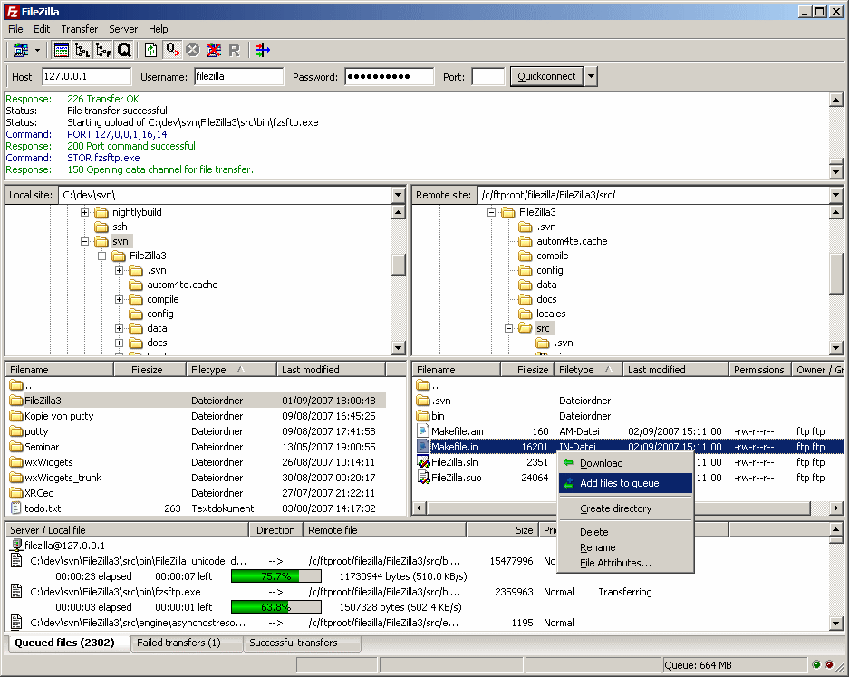


SSH/SFTP: From Window
Putty
FileZilla

Slide 25
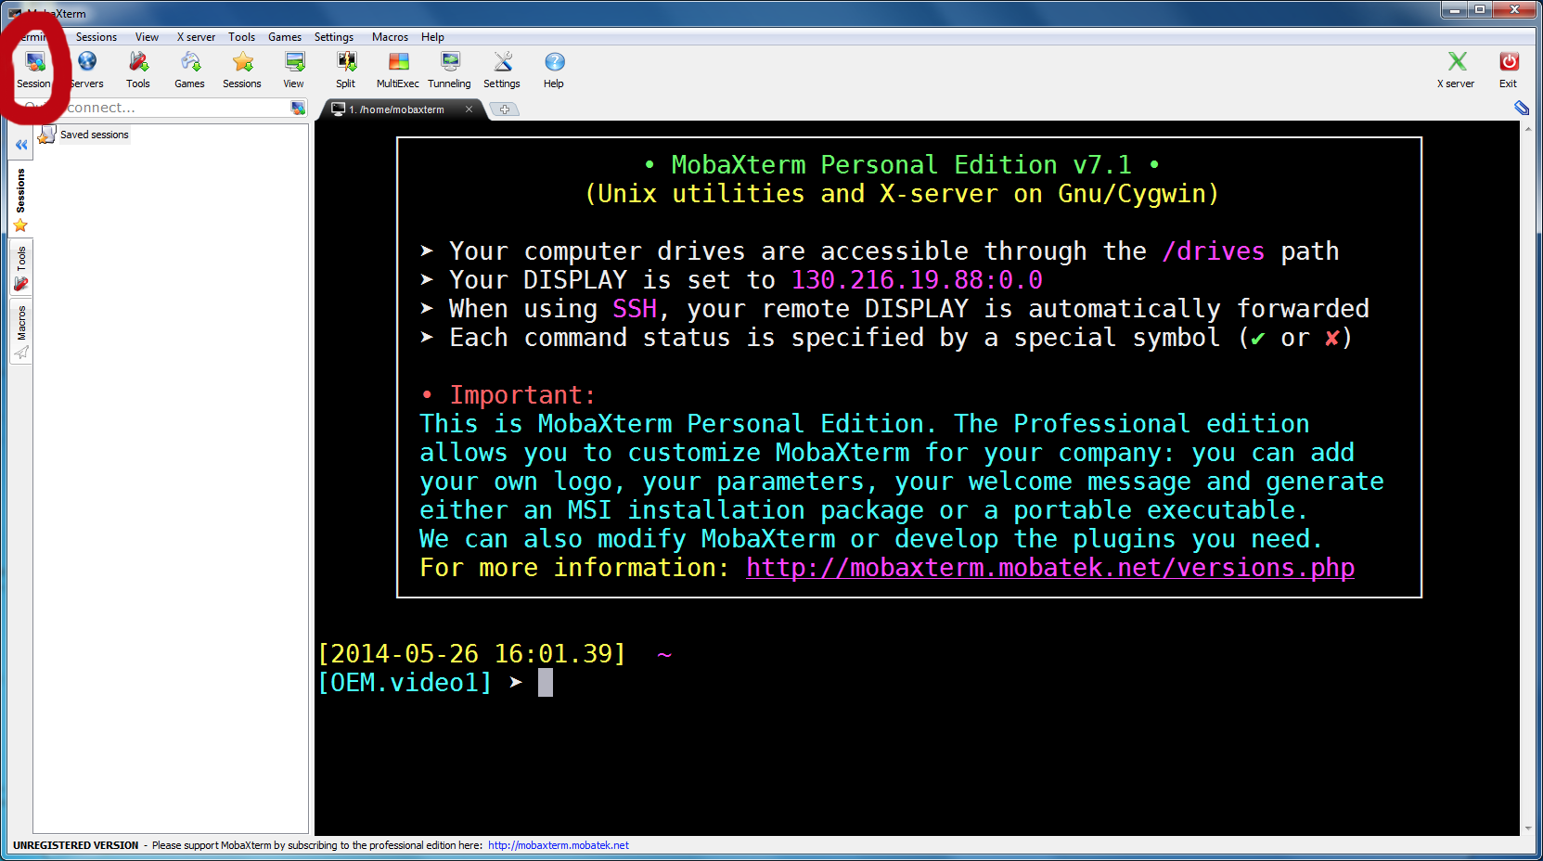

SSH/SFTP: From Window
MobaXterm

Slide 26
Editor: Vim or Other GUI Editor
[Recommend] Linux build-in editor: Vim
vim filename: Load the file for vim editing.
Vim Tutorial
[Appendix] Use other editor with GUI.
E.g. Notepad++, Sublime Text
[SSH by MobaXterm] MobaXterm will sync remote files and local files.
[SSH by Terminal] Need some plugins of editor.

Slide 27
Development Environment
Unix-like Workstation
Makefile: Compile & Link your program
Other Development Tools
GDB Debugger: Debug your program.
Git & GitHub: Revision Control & Collaboration.

Slide 28
GCC: Compile your program
hello.c
gcc/g++ Compiler.
gcc hello.c
gcc -o hello hello.c
[-o]:Name of the executable
gcc –c hello.c
[-c]: Make object file.
#include <stdio.h>
int main(void) {
printf(“Hello.”);
return 0;
}
Executable File
a.out
Executable File
hello
Object File
hello.o

Slide 29
GCC: Link the Object Files
Source Code
a.c
Source Code
b.c
Not Modified
Modified
Compilation
Compilation
Object File
a.o
Linking
Object File
b.o
Executable File
a.out

Slide 30
Some GCC Commands
gcc -Wall hello.c
Enable all compiler's warning messages
gcc -o3 hello.c
Optimization
gcc –I path/of/header/file hello.c
Add the directory of header files
gcc –L path/of/library hello.c
Add the directory of library

Slide 31
Makefile: Compile & Link program
Makefile Rule:
hello.c
a.c
target ... : prerequisites...
<TAB> command
<TAB> …
gcc –c hello.c
gcc –c a.c
hello.o
a.o
target:
The file to make. (E.g. exe/.o/other target)
prerequisites or dependents:
The files that must exist before the target can be
successfully created. (E.g. other .c)
commands:
The shell commands to create the target
from the prerequisites. (E.g. gcc ……)
gcc –o hello hello.o a.o
Executable File
hello

Slide 32
Makefile: Compile & Link program
Makefile Rule:
hello.c
a.c
target ... : prerequisites...
<TAB> command
<TAB> …
gcc –c hello.c
gcc –c a.c
hello.o
a.o
Makefile Example:
hello: hello.o a.o
gcc -o hello hello.o a.o
hello.o: hello.c
gcc -c hello.c
a.o: a.c
gcc -c a.c
gcc –o hello hello.o a.o
Executable File
hello
make hello
Notes:
makefile要自己寫喔

Slide 33
Makefile: Compile & Link program
Make clean Example:
hello.c
a.c
hello: hello.o a.o
gcc -o hello hello.o a.o
hello.o: hello.c
gcc -c hello.c
a.o: a.c
gcc -c a.c
clean:
rm –f hello hello.o a.o
gcc –c hello.c
gcc –c a.c
hello.o
a.o
gcc –o hello hello.o a.o
Executable File
hello
make clean
Makefile Tutorial

Slide 34
Development Environment
Unix-like Workstation
Makefile: Compile & Link your program
GDB Debugger: Debug your program.
Git & GitHub: Revision Control & Collaboration.

Slide 35
Good luck!

